Slide 1
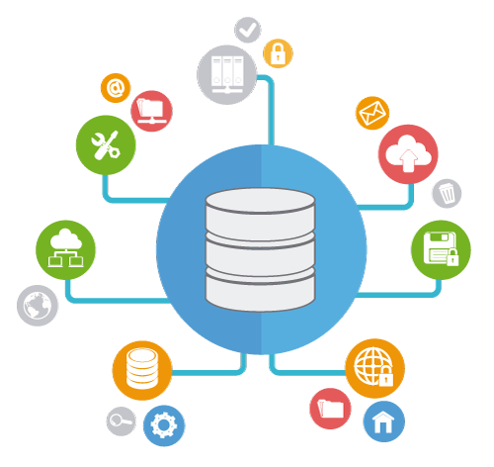
Introduction to Databases
How Do RDBMS Work? Managing DBs Using IDEs
SoftUni Team
Technical Trainers
Software University
https://softuni.bg

Slide 2
Table of Contents
Data Management
Database Engines
Data Types in SQL Server
Database Modeling
Basic SQL Queries
2

Slide 3
Questions
sli.do #csharp-db

Slide 4

Data Management
When Do We Need a Database?

Slide 5


Storage vs. Management (1)
Conventional Data Storage
Notes
Receipts
Notes:
Local store and all invoices

Slide 6

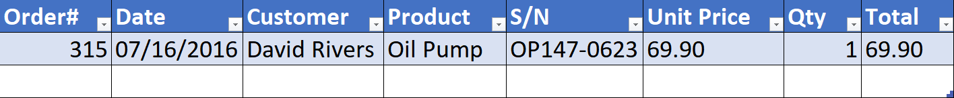
Storage vs. Management (2)
We can group related pieces of data into separate columns
Notes:
Like excel.

Slide 7
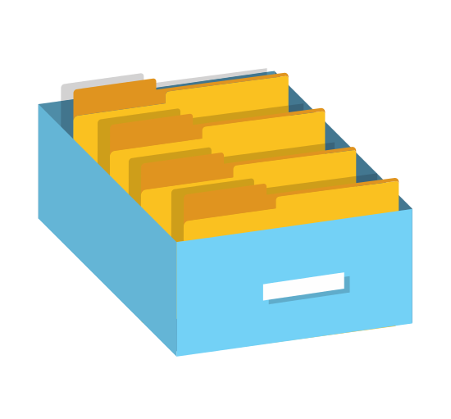
Storage vs. Management (3)
Storing data is not the primary reason to use a Database
Flat storage eventually runs into issues with
Size
Ease of updating
Searching
Concurrency
Security
Consistency

Slide 8
Databases and RDBMS
A database is an organized collection of information
It imposes rules on the contained data
Relational storage first proposed by Edgar Codd in 1970
A Relational Data Base Management System provides tools to manage the database
It parses requests from the user and takes the appropriate action
The user doesn't have direct access to the stored data
8
Notes:
Show how it looks one database file

Slide 9


Database Engines

Slide 10



Database Engine Flow
SQL Server uses the Client-Server Model
Clients
Query
Engine
Access
Database
Data
Data

Slide 11


Download Clients & Servers
Download SQL Server Express Edition from Microsoft
Download SQL Server Management Studio separately
go.microsoft.com/fwlink/?linkid=866662
https://aka.ms/ssmsfullsetup

Slide 12

SQL Server Architecture
Logical Storage
Instance
Database
Schema
Table
Physical Storage
Data Files and Log files
Data Pages
Instance
Database
Database
Schema
Table
Table
Table
Database
Schema
Data
Logs
☰
☰
☰
☰
☰
☰
☰
☰

Slide 13
Database Table Elements
The table is the main building block of any database
Each row is called a record or entity
Columns (fields) define the type of data they contain
Column
CustomerID | FirstName | Birthdate | CityID
1 | Brigitte | 03/12/1975 | 101
2 | August | 27/05/1968 | 102
3 | Benjamin | 15/10/1988 | 103
4 | Denis | 07/01/1993 | 104
Row
Cell
Notes:
The table is the main unit of data storage. It has rows, columns and cells. Cells contain stored data. Each column has a data type. Types can be VARCHAR(String), INT, DATE etc.

Slide 14
Structured Query Language
To communicate with the Engine we use SQL
Declarative language
Logically divided in four sections
Data Definition – describe the structure of our data
Data Manipulation – store and retrieve data
Data Control – define who can access the data
Transaction Control – bundle operations and allow rollback

Slide 15

Data Types in SQL Server

Slide 16
Data Types in SQL Server (1)
Numeric
BIT (1-bit), TINYINT (8-bit), SMALLINT (16-bit)
INT (32-bit), BIGINT (64-bit)
FLOAT, REAL, DECIMAL(precision, scale)
Textual
CHAR(size) – fixed size string
VARCHAR(size) – variable size string
NCHAR(size) – Unicode fixed size string
NVARCHAR(size) – Unicode variable size string
Notes:
DECLARE @VarcharVar VARCHAR(5) = 'Test';
DECLARE @NVarcharVar NVARCHAR(5) = 'Test';
DECLARE @Char CHAR(5) = 'Test';
SELECT DATALENGTH(@VarcharVar), DATALENGTH(@NVarcharVar), DATALENGTH(@Char)

Slide 17
Size of Textual Characters
DECLARE @VarcharVar VARCHAR(5) = 'Test';
DECLARE @NVarcharVar NVARCHAR(5) = 'Test';
DECLARE @CharVar CHAR(5) = 'Test';
DECLARE @NCharVar NCHAR(5) = 'Test';
SELECT DATALENGTH(@VarcharVar),
DATALENGTH(@NVarcharVar),
DATALENGTH(@CharVar),
DATALENGTH(@NCharVar)

Slide 18
Data Types in SQL Server (2)
Binary data
BINARY(size) – fixed length sequence of bits
VARBINARY(size) – a sequence of bits, 1-8000 bytes or MAX (2GB)
Date and time
DATE – date in range 0001-01-01 through 9999-12-31
DATETIME – date and time with precision of 1/300 sec
DATETIME2 – type that has a larger date range
SMALLDATETIME – date and time (1 minute precision)
TIME – defines a time of a day (no time zone)
DATETIMEOFFSET – date and time that has time zone
Notes:
DateTime DateTime2
Min Value 1753-01-01 00:00:00 - 0001-01-01 00:00:00
Max Value 9999-12-31 23:59:59.997 - 9999-12-31 23:59:59.9999999

Slide 19
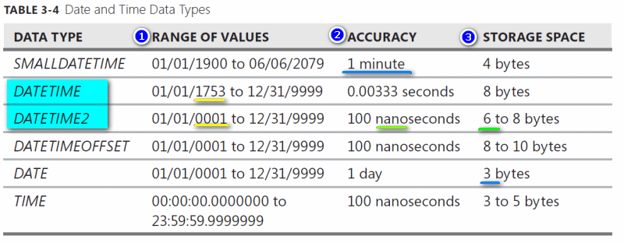
Date and Time in SQL Server

Slide 20
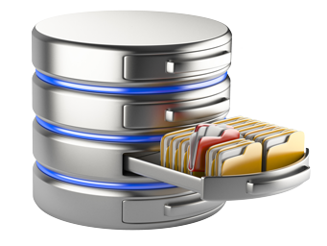
Database Modelling
Data Definition Using SSMS

Slide 21
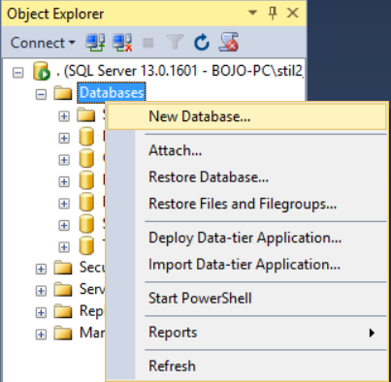
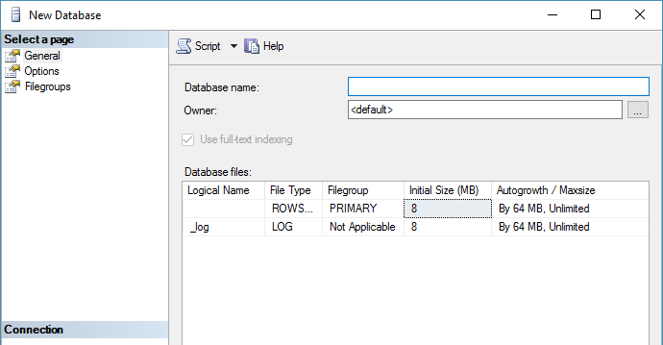
Creating a New Database
Select New Database from the context menu under "Databases"
You may need to Refresh [F5] to see the results

Slide 22
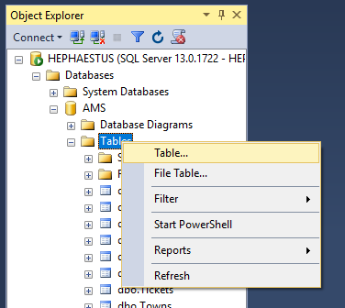
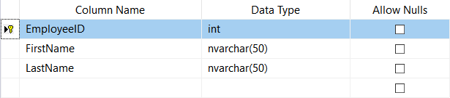
Creating Tables (1)
From the context menu under "Tables" inside the desired database
Table name can be set from its Properties [F4] or when it is saved

Slide 23
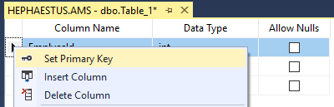
Creating Tables (2)
A Primary Key is used to uniquely identify and index records
Setting primary key on a column:

Slide 24
Creating Tables (3)
Identity – The value in the column is automatically incremented when a new record is added
These values cannot be assigned manually
Identity Seed – the initial number (1 by default)
Identity Increment – how much each consecutive value is incremented

Slide 25
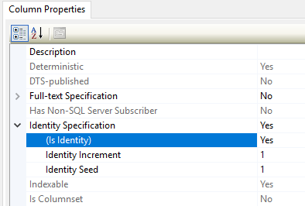
Creating Tables (4)
Setting an identity through the "Column Properties" window:

Slide 26
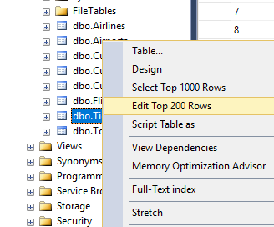
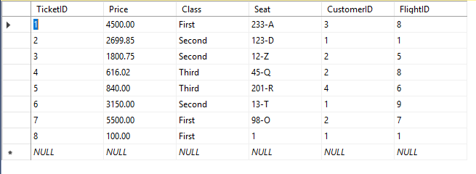
Storing and Retrieving Data (1)
We can add, modify and read records with Management Studio
To insert or edit a record, click Edit from the context menu
Enter data at the end to add a new row

Slide 27
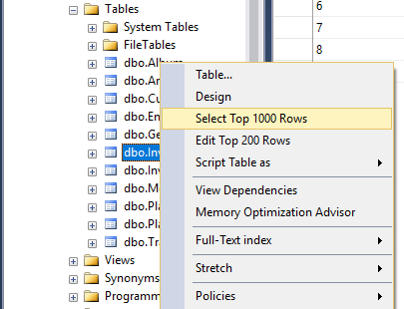
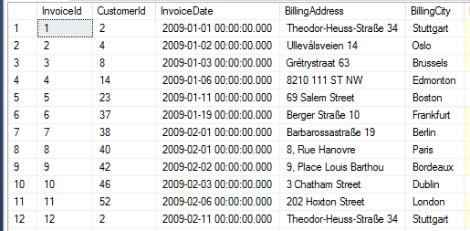
Storing and Retrieving Data (2)
To retrieve records, click Select from the context menu
The received information can be customized with SQL queries

Slide 28
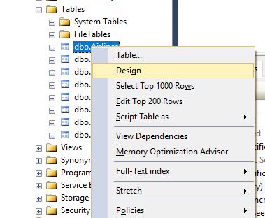
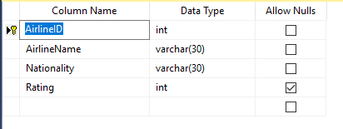
Altering Tables
You can change the properties of a table after its creation
Select Design from the table's context menu
Changes cannot conflict with existing rules!

Slide 29

Basic SQL Queries
Data Definition Using T-SQL

Slide 30
SQL Queries
We can communicate with the database engine using SQL
Queries provide greater control and flexibility
To create a database using SQL:
SQL keywords are traditionally capitalized
Database name
CREATE DATABASE Employees

Slide 31
Table Creation in SQL
Table name
CREATE TABLE People
(
Id INT NOT NULL,
Email VARCHAR(50) NOT NULL,
FirstName VARCHAR(50),
LastName VARCHAR(50)
)
Custom attributes
Data type
Column name

Slide 32
Retrieve Records in SQL
To get all records from a table
You can limit the number of rows and number of columns
SELECT * FROM Employees
Number of records
List of columns
SELECT TOP (5) FirstName, LastName
FROM Employees

Slide 33

Summary
RDBMS store and manage data
Table relations reduce repetition and complexity
Table columns have fixed types
We can use Management Studio to create and customize tables
SQL provides greater control over actions
…
…
…

Slide 34
Questions?
Notes:
34

Slide 35












SoftUni Diamond Partners

Slide 36


Educational Partners

Slide 37
Trainings @ Software University (SoftUni)
Software University – High-Quality Education, Profession and Job for Software Developers
softuni.bg, about.softuni.bg
Software University Foundation
softuni.foundation
Software University @ Facebook
facebook.com/SoftwareUniversity
Software University Forums
forum.softuni.bg
37
Notes:
37

Slide 38

License
This course (slides, examples, demos, exercises, homework, documents, videos and other assets) is copyrighted content
Unauthorized copy, reproduction or use is illegal
© SoftUni – https://about.softuni.bg
© Software University – https://softuni.bg
Notes:
38

